Slide 1
Facilitating Learning in Small Groups
Faculty Development Materials
Prepared by
Ellen Goldman and Andrea Scott
February 19, 2014

Slide 2
Contents
Factors contributing to group effectiveness
Value of small group learning
Characteristics of effective learning groups
Leadership styles & roles in small groups
Preparation for leading small group learning
Facilitation of small group learning
Design Features to maximize learner involvement
Group behaviors and options for dealing with them
Questions to promote dialogue
Co-facilitation strategies
Ideas for evaluating small group learning
References

Slide 3
Factors Contributing to Group Effectiveness
Group Context
Organizational elements
mission, culture, resources, rewards
Group Structure
Stable characteristics of the group
Purpose, culture, tasks, membership, roles, responsibilities, norms
Group Process
How things are done
problem-solving, decision-making, conflict management, communications
Source: Schwartz, 2002.

Slide 4
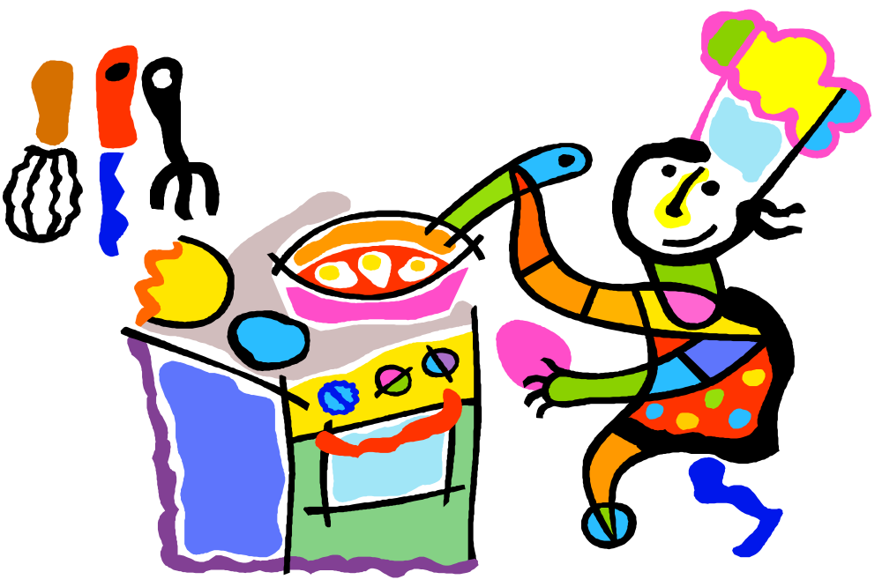
Creative teaching, like creative cooking, requires improvisation and artistry, sometimes even inventing elements of the process as you go along*.
* Westberg & Jason, 1996, p. xiii.

Slide 5
Value of Small Group Learning
For Students
For Faculty
Provides a sense of ownership of learning
Allows for practice
Encourages collaboration and peer learning
Facilitates meaning-making
Fosters active listening
Fosters teambuilding
Allows for learning by teaching
Provides opportunity to use a variety of active learning techniques
Allows for observation
Fosters diagnosis of learners’ needs
Provides immediate feedback on learning
Permits participation as a learner
Source: Westberg & Jason, 1996

Slide 6
Characteristics of Effective Learning Groups
Faculty comfort and skill with facilitation.
An environment of mutual respect and trust.
Group size conductive to all actively participating; 5-8 is optimal.
Diverse composition.
Stable group membership.
Common sense of direction and purpose.
Sufficient introductory time.
Learners’ acceptance of ownership of working together and responsibility for each other.
Clear roles, responsibilities & decision-making.
Varied activities, consistent with goals.
Constructive dealing with conflict.
Self-monitoring and evaluation.
Source: Westberg & Jason, 1996

Slide 7
Leadership Styles with Small Groups
Depends on:
Difficulty of directions
Difficulty of content
Nascence of group
Skills within group
Direct
Coach
Support
Delegate
Source: Westberg & Jason, 1996

Slide 8
Leadership Roles to Promote Small Group Learning of New Material
Diagnose what learners need and want
Model capabilities learners need to develop
Coach
Fade away
Source: Westberg & Jason, 1996

Slide 9
Preparing to Lead a Small Groups
Reflect On
your own group experiences as a participant: activities, trust, collaboration, evaluation
your past small group teaching experiences: what worked; what didn’t
the characteristics of the learners and their experience with group learning.
Determine
what you need to do to be as effective as possible
how the introductory time should be used
problems that might occur and how you will handle them
room and other preparations
Source: Westberg & Jason, 1996

Slide 10
Essential Introductory Time
Welcome! Introductions! Authentic Personal Sharing!
then…….Group Goals! Group Evaluation!
….Establishes learning environment
….Allows learners time to get acquainted and begin to
develop trust
….Sets expectations for group learning
….Clarifies direction and purpose of group
….Provides opportunity to practice interaction
….Provides learners with a sense of ownership of their
learning
….Provides opportunity for immediate feedback from group,
identifying issues requiring attention
Source: Westberg & Jason, 1996

Slide 11
Facilitator’s Tasks
The facilitator’s task is to increase effectiveness by improving process and structure, not by intervening with content ….*
Establish group rules for effective process
Identify inconsistent & consistent behaviors to ground rules & core values
Help members learn more effective behavior
*Schwartz, 2002, p. 3

Slide 12
Session Facilitation Outline
Check in: How are they doing? Any reflections?
Set goals for the session
Explain the value of activities
Discuss roles and responsibilities
Develop ground rules: Conditions that will help learning
Start with what most interests the learner
Facilitate the flow: Ask questions, keep group focused, help transition
Observe the learners’ behaviors: Encourage, provide constructive feedback
Deal with and negative behaviors
Deal with disagreements
Summarize
Reflect individually and as a group….on content and process.

Slide 13
Design Features to Maximize Learner Involvement and Group Effectiveness
Prior to Group Discussions
All work on the same assignment but use the content concepts to make a specific, individual choice (promotes individual accountability)
During Discussions WITHIN Groups
Share members’ individual choices and reach consensus.
Focus the discussion on “why” or “how” (promotes understanding vs. an “answer”)
During Discussion BETWEEN Groups
Report out simultaneously. Digest entire set of “reports” before beginning discussion (values all)
Focus the discussion on “why” or “how”
Source: Michaelsen, Knight & Fink, 2004

Slide 14
Learning Behaviors in Groups
Unilateral Control--------------------------Mutual Learning
Are discussion and dialogue being facilitated?
listening, rephrasing, building, questioning
Are negative behaviors taking place?
tardiness, digressions, side conversations
Are individuals playing routine roles over time?
Are some “socially loafing”? Why?
What non-verbals are occurring?
How is the group evolving?
Source: Schwartz, 2002

Slide 15
Dealing with Negative Group Behaviors……
Use a macro intervention before a micro one:
I want to check to see if the conversation is on track…how are the comments being made related to topic X?
Ask the group to self-assess by describing the behavior:
Mary is trying to talk for 3x times already…what might be going on?
Help the group change their behavior:
What can you do to make sure you are adhering to your ground rules about listening to one another?
Reinforce positive behaviors:
That was a great way of building on previous comments.
Source: Schwartz, 2002

Slide 16
Dealing with Negative Individual Behaviors……
Intervene in stages:
Catch their eye
Provide nonverbal feedback
Raised brow
3. Offer a reminder of relevant ground rules
GR #3 asks for side conversations to be avoided.
4. Offer a verbal description of what you are observing
I am observing a lot of side chatter…what is going on?
5. Describe your own reaction
When you do not listen to the person speaking it makes me think you do not value them as a co-learner.
Source: Schwartz, 2002

Slide 17
Dealing with Emotions……
First, observe, don’t infer:
Your face is red and you’ve pushed away from the table (vs. you are angry)
Test inferences:
I am inferring you do not want to do things X way because you don’t think it will help you…is my inference correct? (vs. You do not like X)
Explain how behavior is problematic:
I am inferring you think this some other way of approaching this is better? Is that correct? I am asking because if this is the case, then what we have planned will not work.
Expect disagreement with you:
Tell me what I missed.
Ask for repetition:
Tell me what you said again because I want to follow up.
Source: Schwartz, 2002

Slide 18
Questions to Promote Dialogue
Can someone summarize the main points?
What do you think about (point #1)?
What would you do and why?
Can you share how you came to that conclusion?
Can we have some other points of view?
No one has said this (unspoken point of view). What do you think?
How can we explain the variance in responses?
How does this connect to what we said earlier about that?
How does this make you feel?
What were each of you thinking when?
What is it about X that makes it a good solution?
What assumptions are we making?
Some people think these groups are just an opportunity to prove you read the material…do you think this is true?
What are your thoughts about continuing this discussion or moving to the next topic?
Source: Schwartz, 2002; Westberg & Jason, 1996

Slide 19
Co-Facilitation
Advantages: Models professional collaboration; provides learners with diversity, provides faculty back-up
Disadvantages: Conflicting approaches to learning; models ineffective team behavior; competition for air-time
Strategies for Success
PREPARE
get to know each other; discuss expectations; decide how to share responsibilities; develop a session plan; agree on ways to communicate during the session.
PERFORM
model the interaction; support each other’s leadership; reinforce each other’s contributions; share spotlight; communicate non-verbally throughout the session
PROCESS
share and compare impressions; critique partnership; critique own efforts; provide constructive feedback to each other.
Source: Westberg & Jason, 1996

Slide 20
Ideas for Evaluating Small Group Learning
 | Formative | Summative
Content | Practice questions, problems, cases, etc. Feedback on learning by teaching (of members) | Exams Reflection Papers
Process | Informal process check discussion Use of a process thermometer Check against ground rules Check against characteristics of effective small group learning | Graded observation Portion of grade by peers

Slide 21
References
Michaelsen, L.K., Knight, A.B. & Fink, L.D. (2004). Team-based learning: A transformative use of small groups in college teaching. Sterling, VA: Stylus.
Schwarz, R. (2002). The skilled facilitator: A comprehensive resource for consultants, facilitators, mangers, trainers, and coaches. San Francisco: Jossey-Bass.
Westberg, J. & Jason, H. (1996). Fostering learning in small groups: A practical guide. New York: Springer.

Slide 22
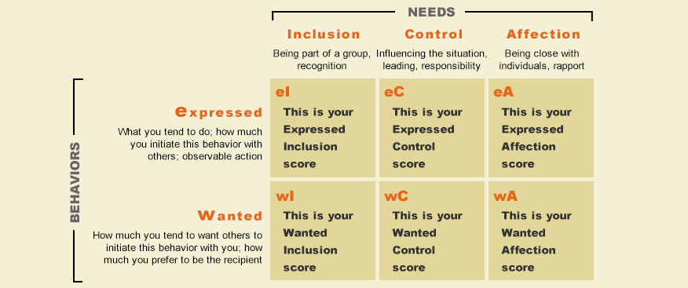

FIRO
Fundamental Interpersonal Relations Orientation

Slide 23
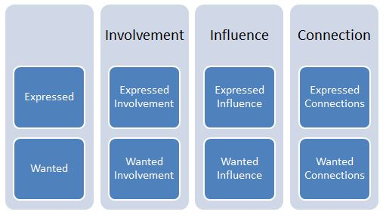
FIRO-B

Slide 24
Discussion Prompts and Prods
Prompting Discussion:
Especially in large group settings, it is often challenging to “get the discussion going” when posing a question to the room. The following can be helpful:
1. Start by asking a few yes/no questions that require a “show of hands.” This gets those present into the act of participating.
A. If not everyone participates, ask for an “undecided” count.
B. Even if there is a clear correct majority response, ask for a volunteer to explain why the answer is correct (after indicating to the room that it is).
C. If there is no clear majority, ask for a few volunteers to explain why they voted the way they did.
D. If no one responds….WAIT…and let the room know you need them to respond.
2. Move to a non-yes/no question that is relatively easy….i.e.: “describe” something. Start with one volunteer and then ask for others to add to what was said. Write the responses on the board if possible, so everyone can see their contribution (this encourages more contributions).
3. On more difficult content or cases, have students work in pairs first to build confidence.
4. Ask the room to generate what might be a good exam question…this also tells what they are having trouble with…and then have the room answer the questions.
5. Ask for specific sections of the room that have been quiet to respond.

Slide 25
Discussion Prompts and Prods
Keeping Groups on Track:
Small group work is a good precursor for the team-based environment of the workplace. However, in the classroom, it is often a challenging to “keep groups on track” and not misuse valuable class time. The following can be helpful:
1. Maintain group size at 5-8. This encourages participation and discourages social loafing.
2. Establish clear roles & responsibilities. Everyone in the group should have a “job” even if it is to observe the group process (which is a great learning experience all by itself).
3. Identify a clear desired outcome (calculate, draw, list, etc.). This signals when the group work is complete.
4. Establish group rules for effective process. These are conditions that will help learning.
5. Establish comfort. Ask the members of each group to share something like their birthday to allow them to introduce themselves to one another and set an equal tone.
6. Ask the groups to stop after half the time is elapsed and self-assess (what are you doing that is effective? What can you do to make sure you are adhering to the group rules?).
7. Reinforce positive behaviors (that was a great way of building on previous ideas).
8. Deal with negative behaviors (non-verbally first, then by referencing ground rules).
9. Avoid the “all report out trap.” Start with one group and ask for additions only.
10. Foster reflection on the process. Have each group identify one thing that made it work well.

