Slide 1

It’s Not Over When It’s Over:
The Health Impact of War and Political Conflict
Allen R. Dyer, MD, PhD
Professor of Psychiatry and Behavioral Sciences
Vice Chair for Education
The George Washington University
adyer@gwu.edu
Notes:
It is a great pleasure for me to be back at ETSU and an honor to be part of this distinguished lecture series.
The story I want to tell tonight has its origins right here, when in 2001 ETSU received a major grant from the Meridian Foundation in Washington to help the Kurds in Iraq develop and strengthen their medical infrastructure. Even before 9-11, Iraq was on the national agenda.
Major universities like Harvard competed for this grant, and we got it.
At first several delegations of Kurdish physicians came to Tennessee to observe what ETSU was doing in rural health.
We developed strong friendships that continue to this day.
I want to focus on lessons learned from this work and draw broader implications for health, global health and mental health.

Slide 2
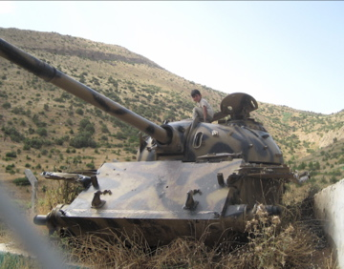
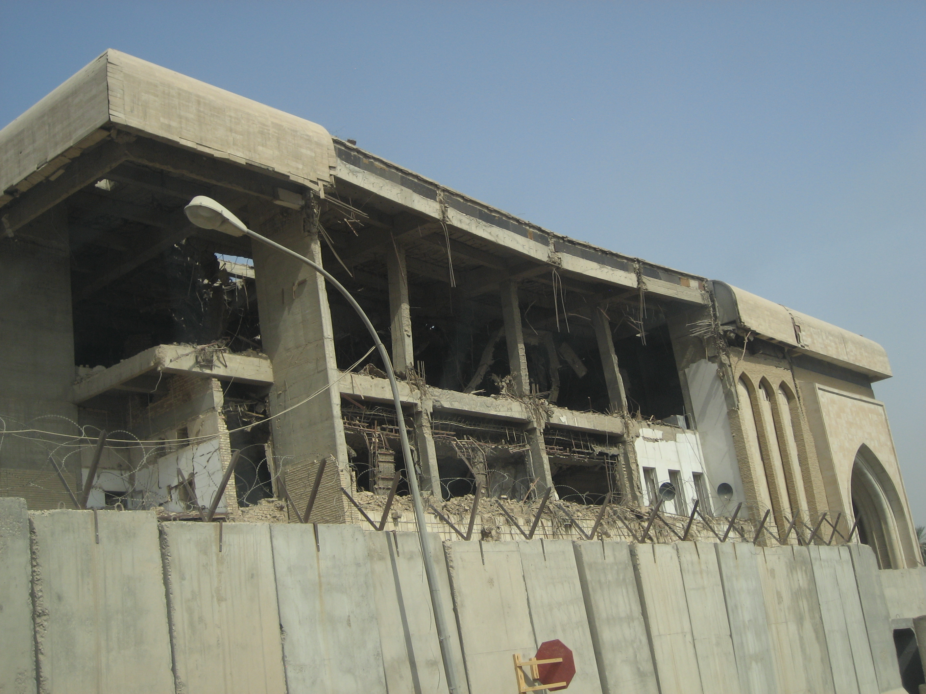
Iraq on the Ground:
The View Through the Psychiatrist’s Lens
Bhath Party HQ, Baghdad
Kurdish boy on captured Iraq tank
Notes:
PTSD is the obvious correlate of war trauma, but my work in global health has increasingly impressed on me that the distinction between health and mental health is an artificial distinction for reasons I will elaborate in the subsequent remarks

Slide 3
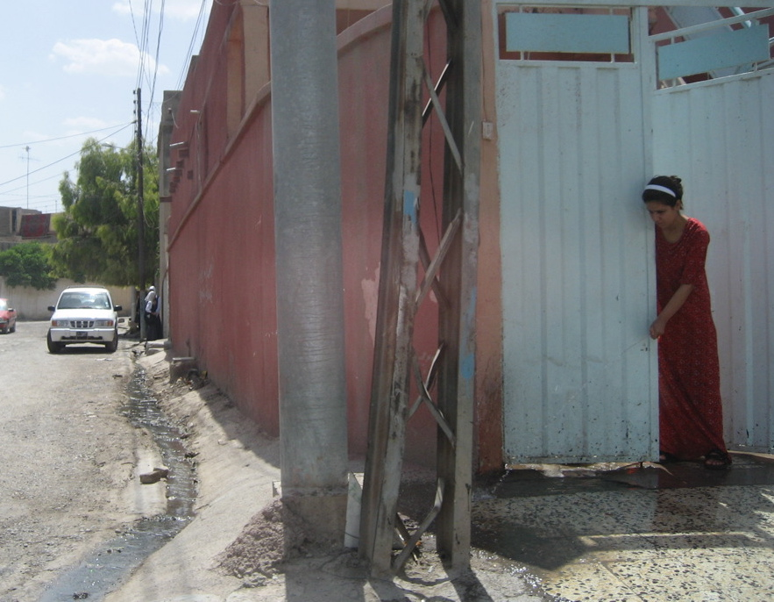
Notes:
My experiences working with Iraqi health professionals since early 2001 and teaching in Iraq since 2007 have impressed on me the on-going stress that people have endured.
I was impressed on my first trip to Iraq in 2007 by the stories people told about the horrors of life with uncertainties of possible loss of one’s own life, but the inevitable loss of friends, murders of family members often in the most gruesome manners.

Slide 4
Iraq Population Profile
Extraordinary stress x 30 years
Incredible resilience
Decreased life expectancy
Increased infant mortality
Resurgence of tuberculosis
Higher than expected incidence of
cancer ➔(7-8 times world rates)⬅
Higher incidence heart disease, diabetes, etc.
High rates of depression, other psychiatric disorders, and substance use disorders
Notes:
As a physician I was also impressed by these narratives about the anxieties people faced, but also by the health impacts -- extraordinary incidence of heart attacks, cancer, headaches, difficulty sleeping, dermatologic conditions, diabetes and difficulty controlling weight – stories which were told as directly part of the stress under which they were living.
Also to note was the extraordinary resilience of the Iraqi people, strong family and community ties and strong religious faith, even as communities were disrupted, families dislocated, and faith challenged – or perhaps worse – politicized.

Slide 5
Our privileges are located on the same map as their suffering, and may—in ways we might prefer not to imagine— be linked to their suffering, as the wealth of some might imply the destitution of others.
The painful stirring images supply only an initial spark.
Susan Sontag, Regarding the Pain of Others
Notes:
Susan Sontag reminds us in her important book, Regarding the Pain of Others, that those beset by war and murderous politics are located on the same map as those of us less directly affected by such wars and murderous policies. Our privilege, she suggests, might be linked to their suffering – in ways we might prefer not to imagine – much as the wealth of some might imply the destitution of others. The painful stirring images supply only an initial spark.
My remarks take up Sontag’s challenge to look closely at the invisible wounds that wars and civil conflicts impose on those involved – everyone is involved – both soldiers and civilians alike.

Slide 6
3 Domains of Trauma
Child
Civilian
Soldier
Notes:
Nomenclature, the names we give things, can help us understand how we conceptualize these situations, the ones we call “traumatic” as a linguistic shorthand for experiences that may be so painful that even talking about them accentuates the pain.
It has become convenient to talk about PTSD as a diagnostic entity that encompasses the psychological difficulties many soldiers have after war experiences.
The “symptoms” of this “disorder”, P-T-S-D, are not just suffered by soldiers, we have come to recognize. Notably people who experienced sexual “abuse” in childhood have similar symptoms, flashbacks, intrusive memories, nightmare, hypervigalence, but not just these symptoms. They have a similar disorder, which we have come to call complex-PTSD.
Civilians in war zones have been less studied, but certainly no less affected.

Slide 7
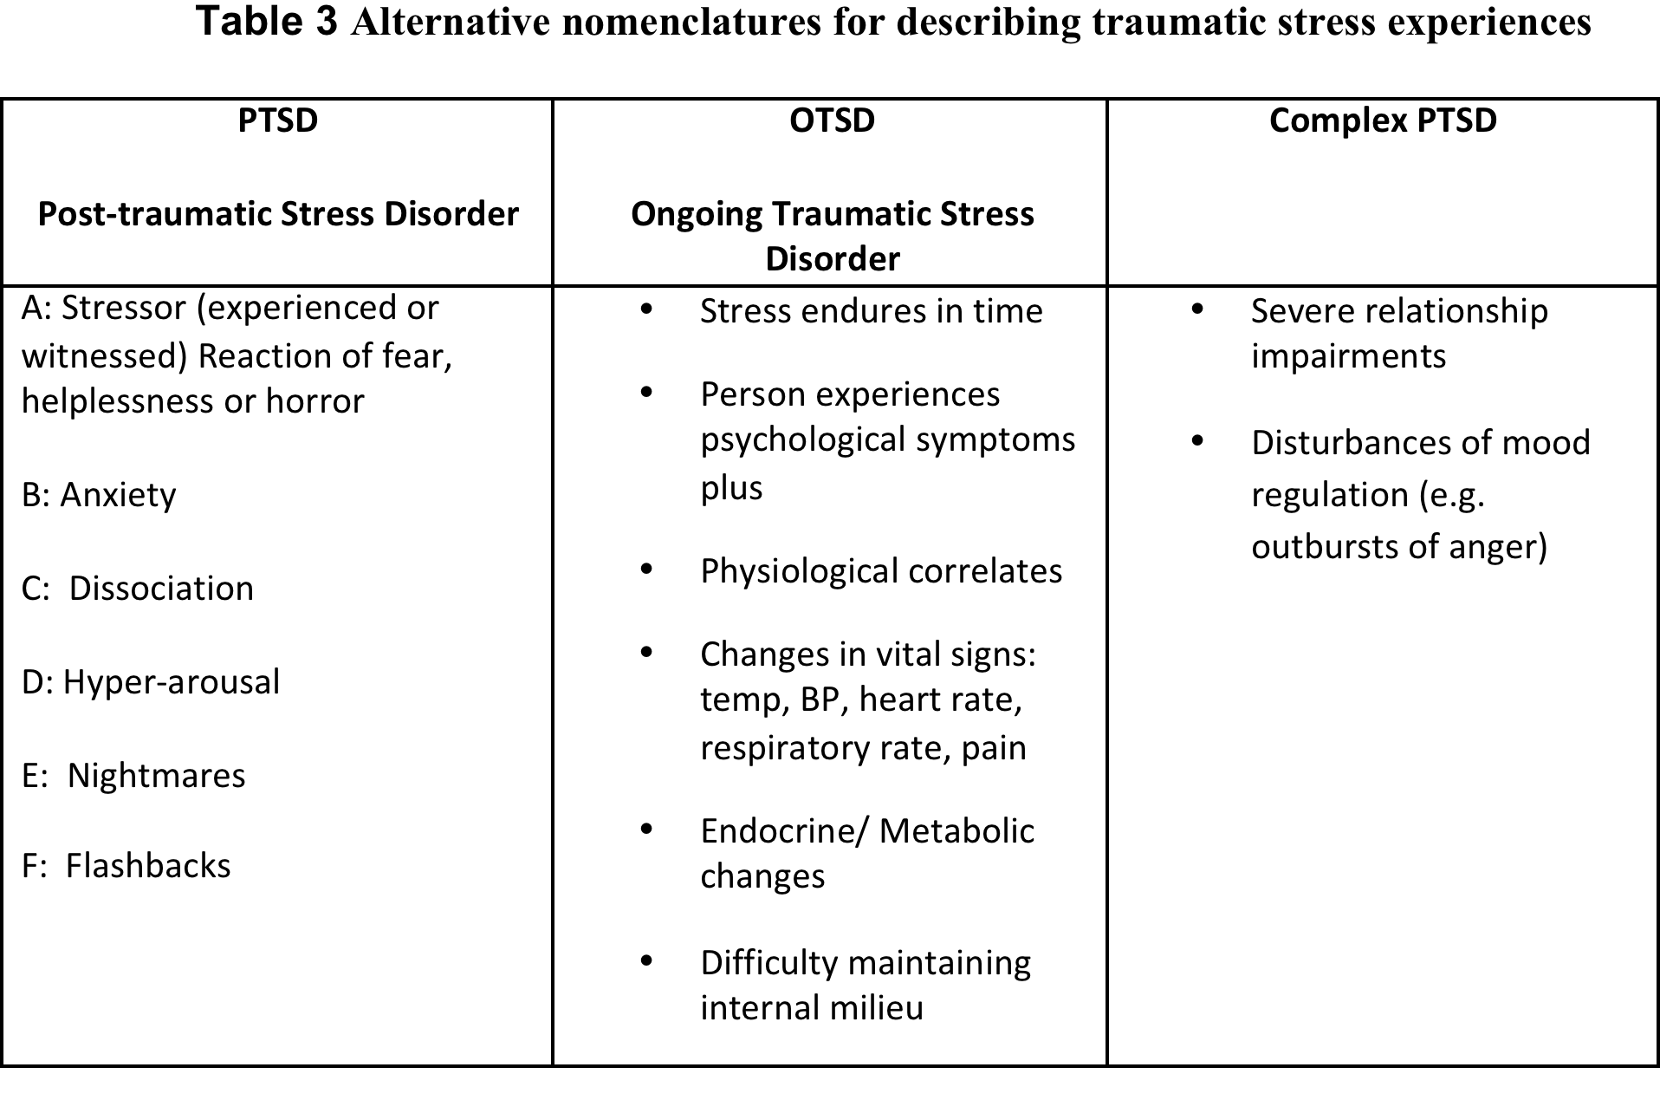
Notes:
The association of physical health problems in the context of on-going stress situations impressed on me that there was a dimension of the health impact that was not captured by the moniker PTSD and led me to suggest that when stress is ongoing, it might be useful to identify it as Ongoing Traumatic Stress Disorder, OTSD in order to emphasize both the physical and psychological health impacts. While we have long recognized the importance of a bio-psycho-social medical model and even a bio-psycho-social-spiritual model, in practical reality these dimensions are usually seen as separate concerns, often addressed by different people. Simply stated, war is bad for your health.

Slide 8
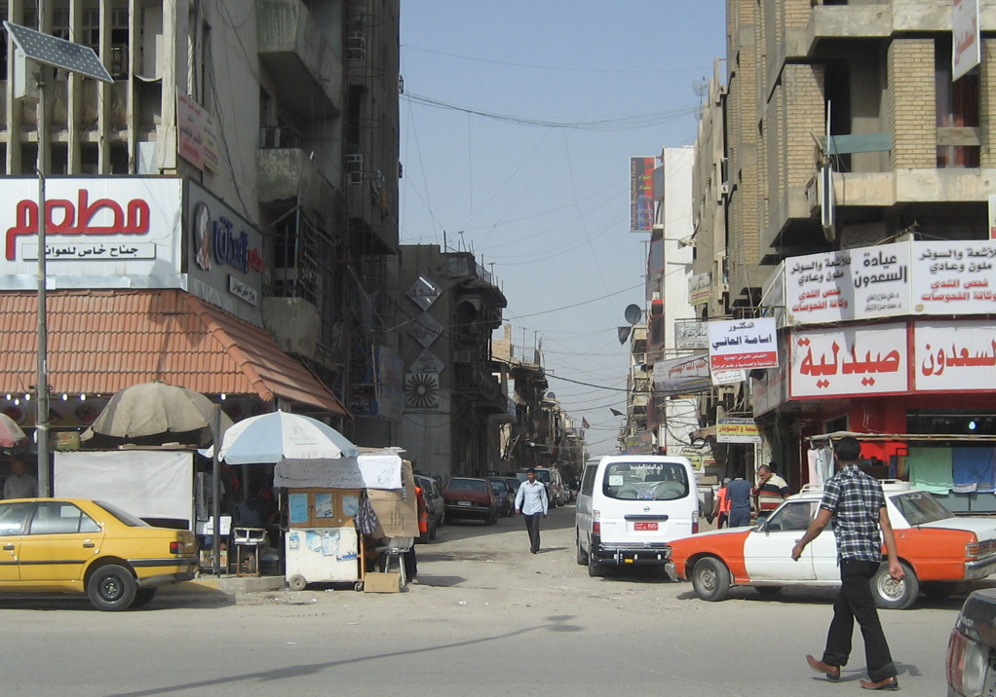
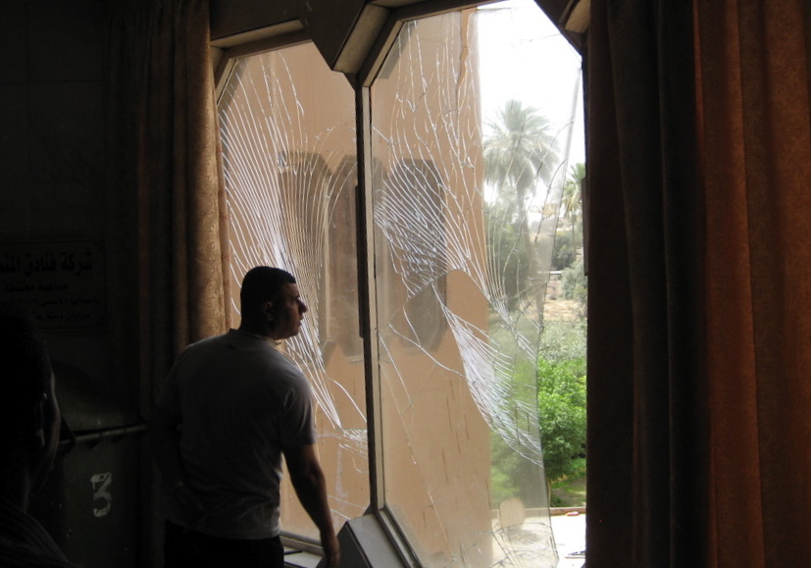
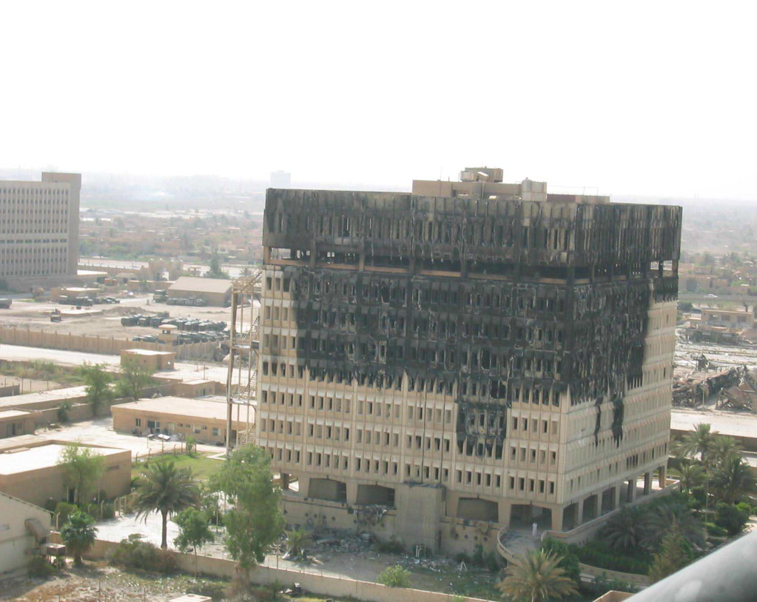
Notes:
War is often cast as a moral struggle, two opposing sides, Us versus Them, Good versus Evil. In the words of Carl von Clausewitz, the famous Prussian general --who gave us perhaps the most accepted definition of war as “the extension of policy by other means”-- “military action is never directed against material force alone: it is always aimed simultaneously at the moral forces which give it life, and the two cannot be separated.”
Whatever moral forces give rise to conflict, the effect is disastrous on ordinary people, soldier or civilian, caught in the crossfire. It may also be disastrous for humanitarian workers, whatever their moral persuasions regarding a particular conflict.

Slide 9
Definition of Trauma is subjective
trauma |noun –
1. a deeply distressing or disturbing experience : they were reluctant to talk about the traumas of the revolution
2. emotional shock following a stressful event or a physical injury, which may be associated with physical shock and sometimes leads to long-term neurosis.
3. Medicine: physical injury.
ORIGIN late 17th cent.: from Greek,
literally Wound.
Notes:
First of all, the definition of trauma is subjective.
The dictionary defines trauma as a deeply distressing or disturbing experience.
More recently trauma has come to be understood as an emotional shock following a stressful event or a physical, which may be associated with a physical shock and sometimes lead to long-term distress.
Finally in medicine, trauma may be a physical injury, belying the etymological origin of the word (from the late 17th century, Greek origin) literally a wound

Slide 10
The brain responds to experiences, not to events.
Whether an adverse event is traumatic
depends upon how the person experienced it.
Shell Shock in soldiers WWI and WWII
PTSD in Soldiers - Post Vietnam
PTSD - post childhood trauma
OTSD - civilians in war/conflict zones
Traumatic Brain Injury - better understood in 21st century complex emergencies
Notes:
The interrelationship of the physical and mental aspects of trauma hints at the stigma associated with PTSD (and any emotional distress) particularly in war situations where “heroism” is the expectation, and anything less may be associated with some overt or implicit culpability, an inability or unwillingness to hide one’s vulnerability or to pretend it doesn’t exist. Considered from the perspective of mental health (well-being) rather than illness, this may be an inability or unwillingness to recognize and acknowledge the reality. Thus PTSD is heir of the misunderstandings of previous wars, where the psychological symptoms were identified as “shell shock”, and treatments (often coercive behaviorist conditioning and shaming tactics) were aimed at getting the soldier back to the front.
Current attempts to better understand Traumatic Brain Injury help us appreciate earlier misunderstandings of shell shock and redress the disservice to those who serve.

Slide 11
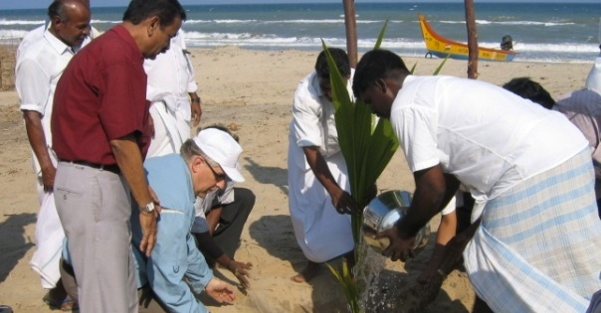
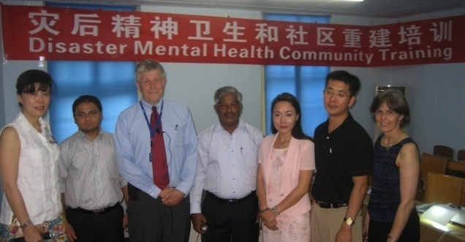
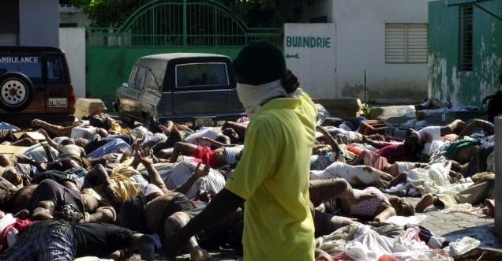
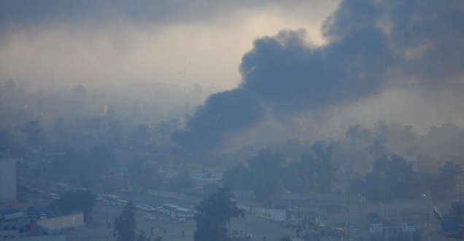
Complex Emergencies:
Tsunami, Earthquake, War
Tsunami Anniversary Rituals, 2005
Great Sichuan Earthquake, 2008
Haiti Earthquake, 2010
Iraq War, Baghdad, 2010
Notes:
Recently the “D” in PTSD has come under question, suggesting posttraumatic stress is not a disorder, but rather an injury.
Particularly in military circles, there has been advocacy for replacing the “D” for disorder with an “I” for injury, the argument being that soldiers and veterans would be more like to seek treatment and treatment would be less stigmatized.
While PTSD is enshrined in the Diagnostic and Statistical Manuals, the abbreviation “posttraumatic stress” is gaining some currency over the more controversial acronym, PTSD.
Indeed calling the response people have in any disaster, natural or man made (human made) a disorder is probably a misnomer.
These are NORMAL RESPONSES TO ABNORMAL SITUATIONS.

Slide 12
Natural history of PTSD
Traumatic Event
1 month
9 months
3 years
Usual onset of symptoms
Many recover without treatment months/years of event (45-80% natural remission at 9 months)
Generally 33% remain symptomatic for 3 years or longer with greater risk of secondary problems
7
Notes:
This slide represents PTSD as a result of a single traumatic event
Secondary problems
Substance use disorders
Depression including the risk of suicide
Other anxiety disorders e.g. panic attacks
Not everyone who experiences a shocking event develops PTSD.
Jonathan Shay – Odysseus in America

Slide 13
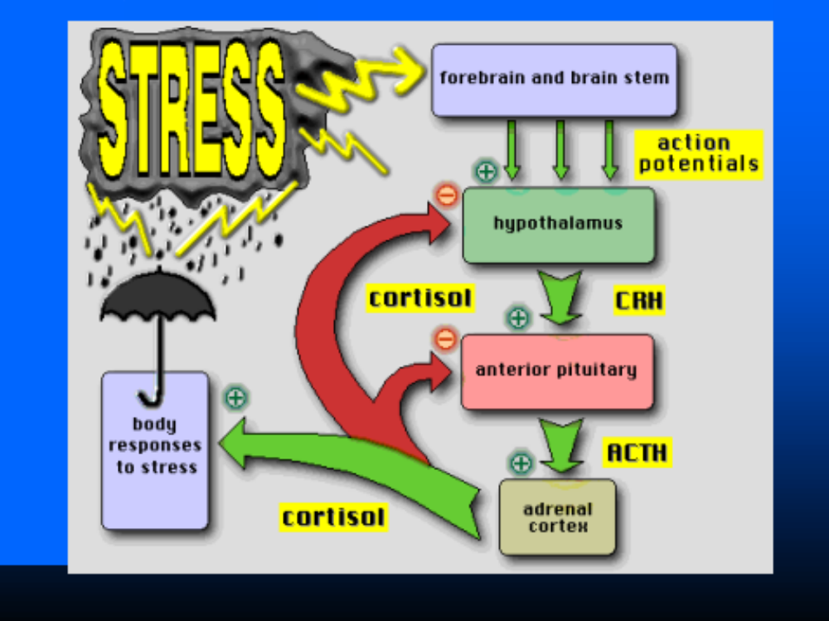
Stress and the Immune System
Notes:
Stress and trauma are related concepts and experienced at basic biological and psychosocial levels. It is worth remembering that “stress” was originally an engineering term applied to materials, which entered the biological lexicon with Walter B Cannon’s The Wisdom of the Body (1932) and Hans Selye’s classic studies of the Stress of Life (1956). Stress involves the complex interactions of mind and body mediated through the endocrine and immune systems. Trauma also has physical roots, damage to materials, but understood psychologically, trauma refers to experiences, such as witnessing an event that involves threatened death or serious injury, which are overwhelming and thus change the person in profound ways.
Because stress and trauma are not synonymous, and because not everyone who experiences stressful situations becomes traumatized, IASC Guidelines (Inter-Agency Standing Committee on Mental Health and Psycho-Social Support, 2011) recommend not using the word “trauma” when stress is meant.

Slide 14
Notes:
In an evolutionary sense, the body has adapted mechanisms to survive stressful experiences. The fight or flight mechanism of the autonomic nervous system has enabled our ancestors to survive encounters with saber-tooth tiger: increased heart rate, increased blood pressure, conversion of stored glycogen in the liver to ready-energy glucose adaptive in a short-term, keep you alive long enough to pass your genes to another generation, but repeated stresses, with the exaggerated cortisol response lead to the adverse health outcomes, hypertension, diabetes, high cholesterol leading to heart damage, asthma, decreased immune function, increased infections, depression, attempts to solve these imbalances with drugs, possibility of neoplasms, and early death.

Slide 15
Rest and relaxation
Fight or flight
Notes:
The sympathetic nervous system pictured on the right is the fight or flight mechanism.
The parasympathetic nervous system on the left is the rest and relaxation response.
All of these physiological changes are automatic and out of our direct control – except – breathing.
Ancient traditions have long recognized that we can calm our nerves by deep, slow breathing, which provides oxygen to the lungs, heart, brain, and restores equilibrium.

Slide 16
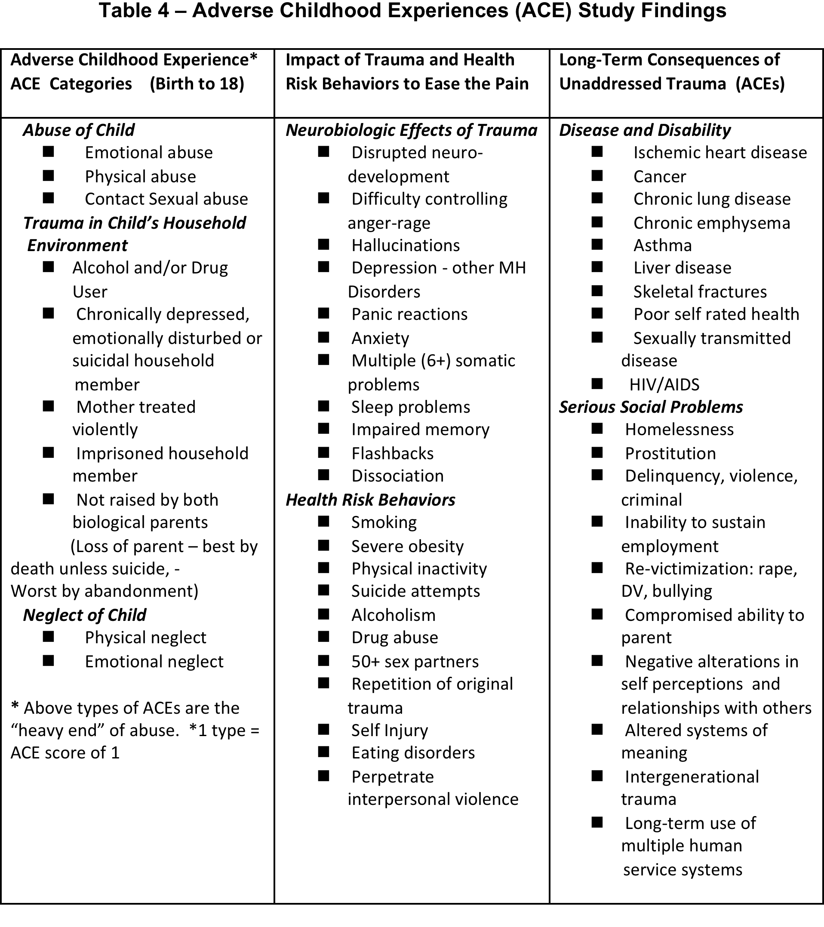
ACE>4
AlOH x 7
Sex<15 x2
Cancer x2
Emphysema x 4
ACE>6
suicide attempt x30
Notes:
One of the most compelling demonstrations of the impact of traumatic experiences – or adverse experiences—on health (outcomes) is the famous ACE (Adverse Childhood Experiences) study (Felitti, et al., 1998). Significant is the direct, rigorous, graded correlation of adverse childhood experiences (such as psychological, physical or sexual abuse, violence against mother, or living with household members who were alcohol and/or substance abusers, someone who is chronically depressed, mentally ill, institutionalized or suicidal, mentally ill or suicidal, or even imprisoned, having only one or no parents, and emotional or physical neglect) on the one hand with (physical) symptoms and illnesses, leading causes of death including ischemic heart disease, cancer, chronic lung disease, skeletal fractures, and liver disease. Perhaps even more important is the intermediate association with a number of maladaptive attempts to cope with the trauma including increased health risks for alcoholism, drug abuse, depression, and suicide attempts, 2-4 fold increase in smoking, poor self-rated health, sexual grazing (>50 sexual partners) and sexually transmitted disease, and increase in physical inactivity and severe obesity. These intermediate symptoms may be considered in isolation as problems in themselves, thus overlooking their multiple and antecedent causes and failing to respond appropriately and effectively to real need. Briefly, the more types of adverse childhood experiences (Column 1), the greater the neurobiologic impacts and health risk behaviors (Column 2), and the more serious the lifelong consequences to health and well-being (Column 3) (Feletti, 1998). Notable is the intermediate column of Health Risk Behaviors, smoking, obesity (or eating disorders), alcohol or drug misuse, other compulsive behaviors, which are often seen as problems in themselves, rather than understood as unsuccessful attempts to ease the pain of dealing with the memories of adverse childhood experiences. Furthermore a large array of chronic “medical” conditions may be understood biologically as entitles unto themselves, when in fact they have complex psychosocial antecedents.
People with an ACE score of 4 were seven times more likely to be alcoholics as adults than people with an ACE score of 0. They were six times more likely to have had sex before age 15, twice as likely to be diagnosed with cancer, four times as likely to suffer emphysema. People with an ACE score above 6 were 30 times more likely to have attempted suicide. Later research suggested that only 3 percent of students with an ACE score of 0 had learning or behavioral problems in school. Among students with an ACE score of 4 or higher, 51 percent had those problems.

Slide 17
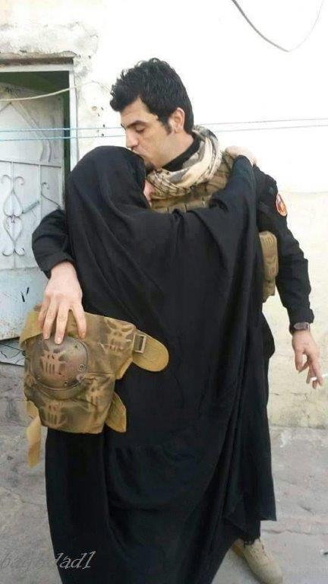

Slide 18
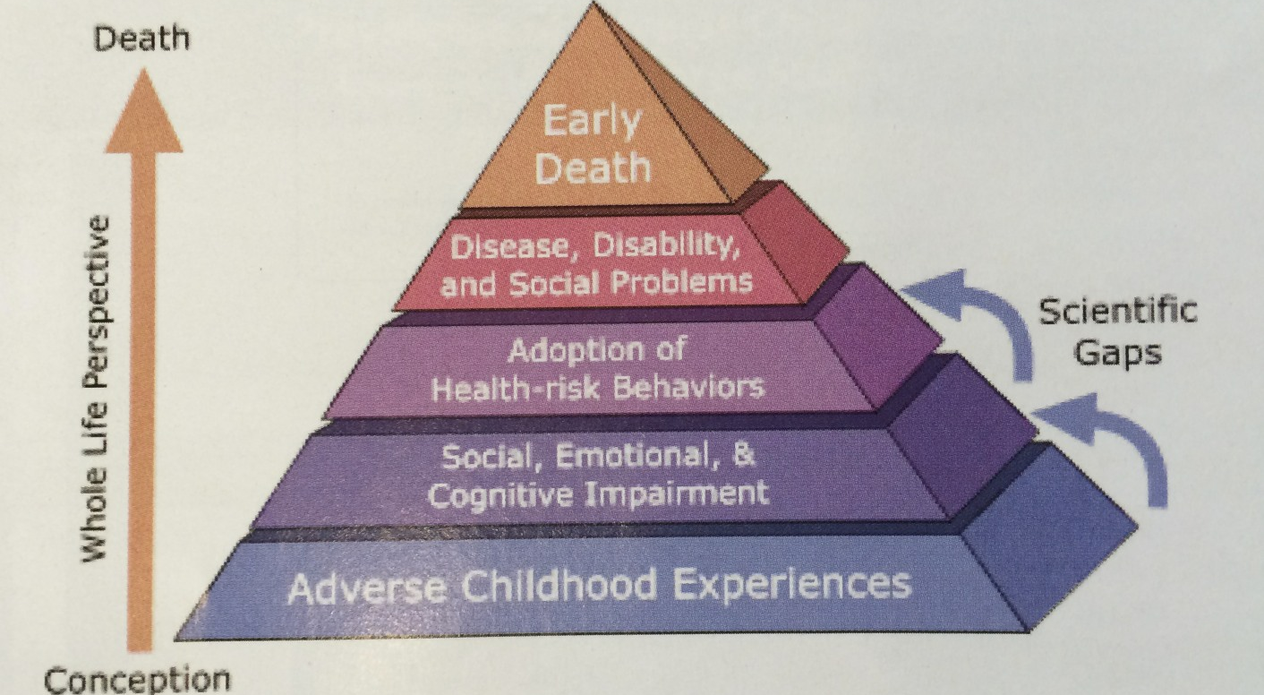
Whole Life Perspective
Adverse Childhood Experiences Pyramid – US Centers for Disease Control and Prevention
Notes:
Feletti’s work is a large n study demonstrating correlation, not causation. The scientific gaps identified in this slide might be explained by the hypotheses I have advanced and warrant further studies.

Slide 19
Table 5 Trauma Experience
WHO Iraq Mental Health Survey (2008)
Exposure to traumatic events
Capture/kidnapping,
imprisoned
purposely causing harm to others
arrest,
being beaten by spouse-
The south/centre shows higher values for the following categories: refugee, internal displacement, exposure to bomb blast, capture, public humiliation, accused of collaboration, beaten by parents as child, beaten by someone else, sexual assault, causing accidental harm to others, witness to killing, death of dear one, family member kidnap, any war related trauma, any trauma and other.
The Kurdistan region shows higher values for the categories life threatening illness.
Notes:
The World Health Organization has designed an ACE International Questionnaire – ACE-IQ.
Questions cover family dysfunction; physical, sexual and emotional abuse and neglect by parents or caregivers;
peer violence; witnessing community violence, and exposure to collective violence.
ACE-IQ is currently being validated through trial implementation as part of broader health surveys.
The WHO Iraq Mental Health Survey conducted in 2008 indicates the types of violence experienced by Iraqis at the height of the war
Note that the Kurdistan region, where many people fled, experienced higher values for the categories of life threatening illness.

Slide 20
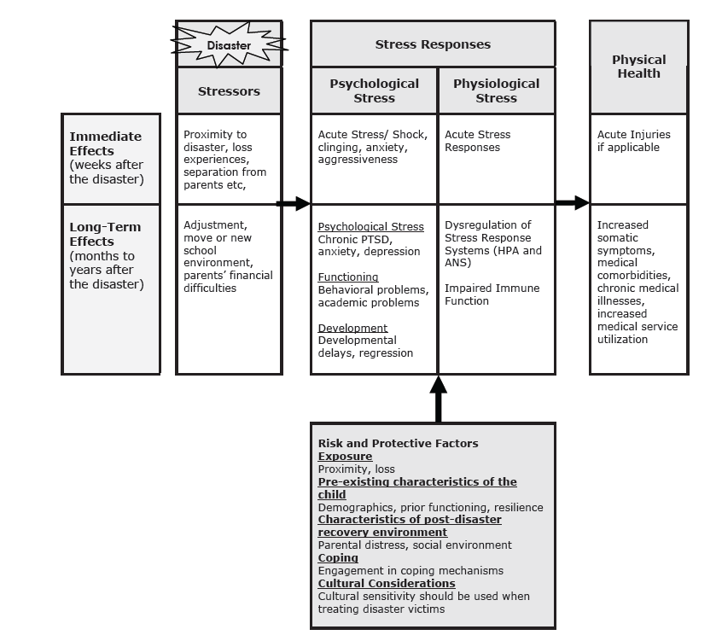

Slide 21
Resilience
the positive capacity of people to cope with stress and catastrophe.
cumulative "protective factors"
used in opposition to cumulative "risk factors"
Notes:
Resilience is the positive capacity of people to cope with stress and adversity. The term, “resilience” like stress also derives from engineering (the ability of a strained body to recover its size and shape after deformation caused by stress), and like Selye’s “stress of life”, resilience has a biological parallel in what Selye called the “General Adaptation Syndrome”. Psychologically as well as physically and biologically, resilience is understood as the ability to “bounce back” from adversity (Bonnano, 2004). Across cultures, family support, social support, civil society, religion and spirituality are among the recognized factors that promote resilience. Humanitarian assistance may be seen as among those factors in which the international community allies with local support systems to tip the balance from distress to adaptation and promote resilience and recovery.

Slide 22
Integration of Mental Health and Psychosocial support and Primary Care
Stress
Resilience
Psycho-logical
Physio-logical
Trauma
Bio
Social
Psycho
Notes:
Where there are no psychiatrists – or too few -- integration of mental health and psychosocial support with primary care
is not just an economic expedient,
it also makes good sense medically and socially.

Slide 23
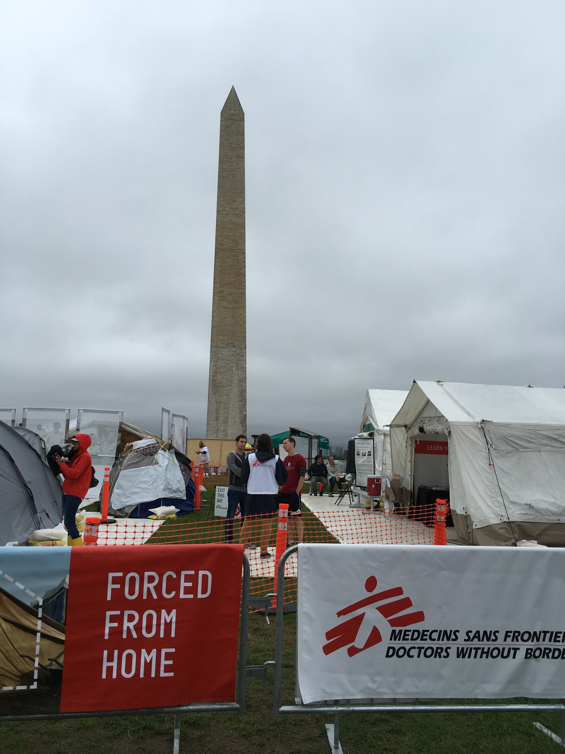
Notes:
While families in communities are among the most robust resilience factors, we are currently facing a global refugee crisis, the largest since WWII.
Medecines Sans Frontier MSF has organized an exhibit on the refugee crisis focus on three desperate situations, the so-called Syrian refugee crisis, Burundi, the long-standing ethic tensions where currently 170, 000 Burundians have fled to Tanzania, and Hondurans, fleeing organized crime and murders into Mexico in hope of reaching the United States.

Slide 24
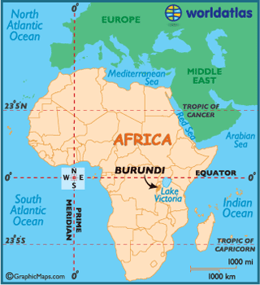
Notes:
I am planning a Fulbright sponsored program in Burundi on Peace and Sustainable Development This was scheduled January, 2016, but was postponed because of violence in the capital Bujumbura. I mentioned the ominous migration of Burundians to Tanzania. What is little appreciated is that the 1994 genocide in Rwanda was preceded in 1993 by a mass migration of 90,000 Tutsis to Rwanda to escape ethic violence in Burundi. War is not over when it’s over.

Slide 25
Restorative Justice v. Retribution
Criminal justice | Restorative justice
Crime is a violation of the law and the state | Crime is a violation of people and relationships
Violations create guilt | Violations create obligations
Justice requires the state to establish blame and impose punishment | Victims, offenders, and community work to put things right
Offenders get what they deserve | Focus on victim needs and offender responsibility

Slide 26
GW Program in Global Mental Health
Refugees arriving on Lesvos Island, Greece, November , 2015
Notes:
The GW Global Mental Health Program
"George Washington University is an innovator in Global Health and Global Mental Health programming recognized internationally for preparing students, residents and faculty to respond to global crises and complex emergency situations. The GWU has touched the lives of vulnerable populations worldwide through programs that foster community support and healing. The GWU community approach builds medical infrastructure through education and consultation and strengthening civil society institutions.” This photo was taken by one of our GW psychiatry residents, Dr. Nicole Nguyen Perras, who was part of a team that did a psychiatric needs assessment in November, 2015. Another resident, Dr. Fatima Noorani, was part of the faculty for our GW Resilience workshop in Athens in June, 2016.

Slide 27
https://sites.google.com/site/gwresilienceworkshop/
Notes:
The George Washington University Workshop BUILDING RESILIENCE IN HUMANITARIAN WORKSHOP – ATHENS
Mitigating burnout in humanitarian workers
Mindful meditation Hope modules, Psychological first aid

Slide 28
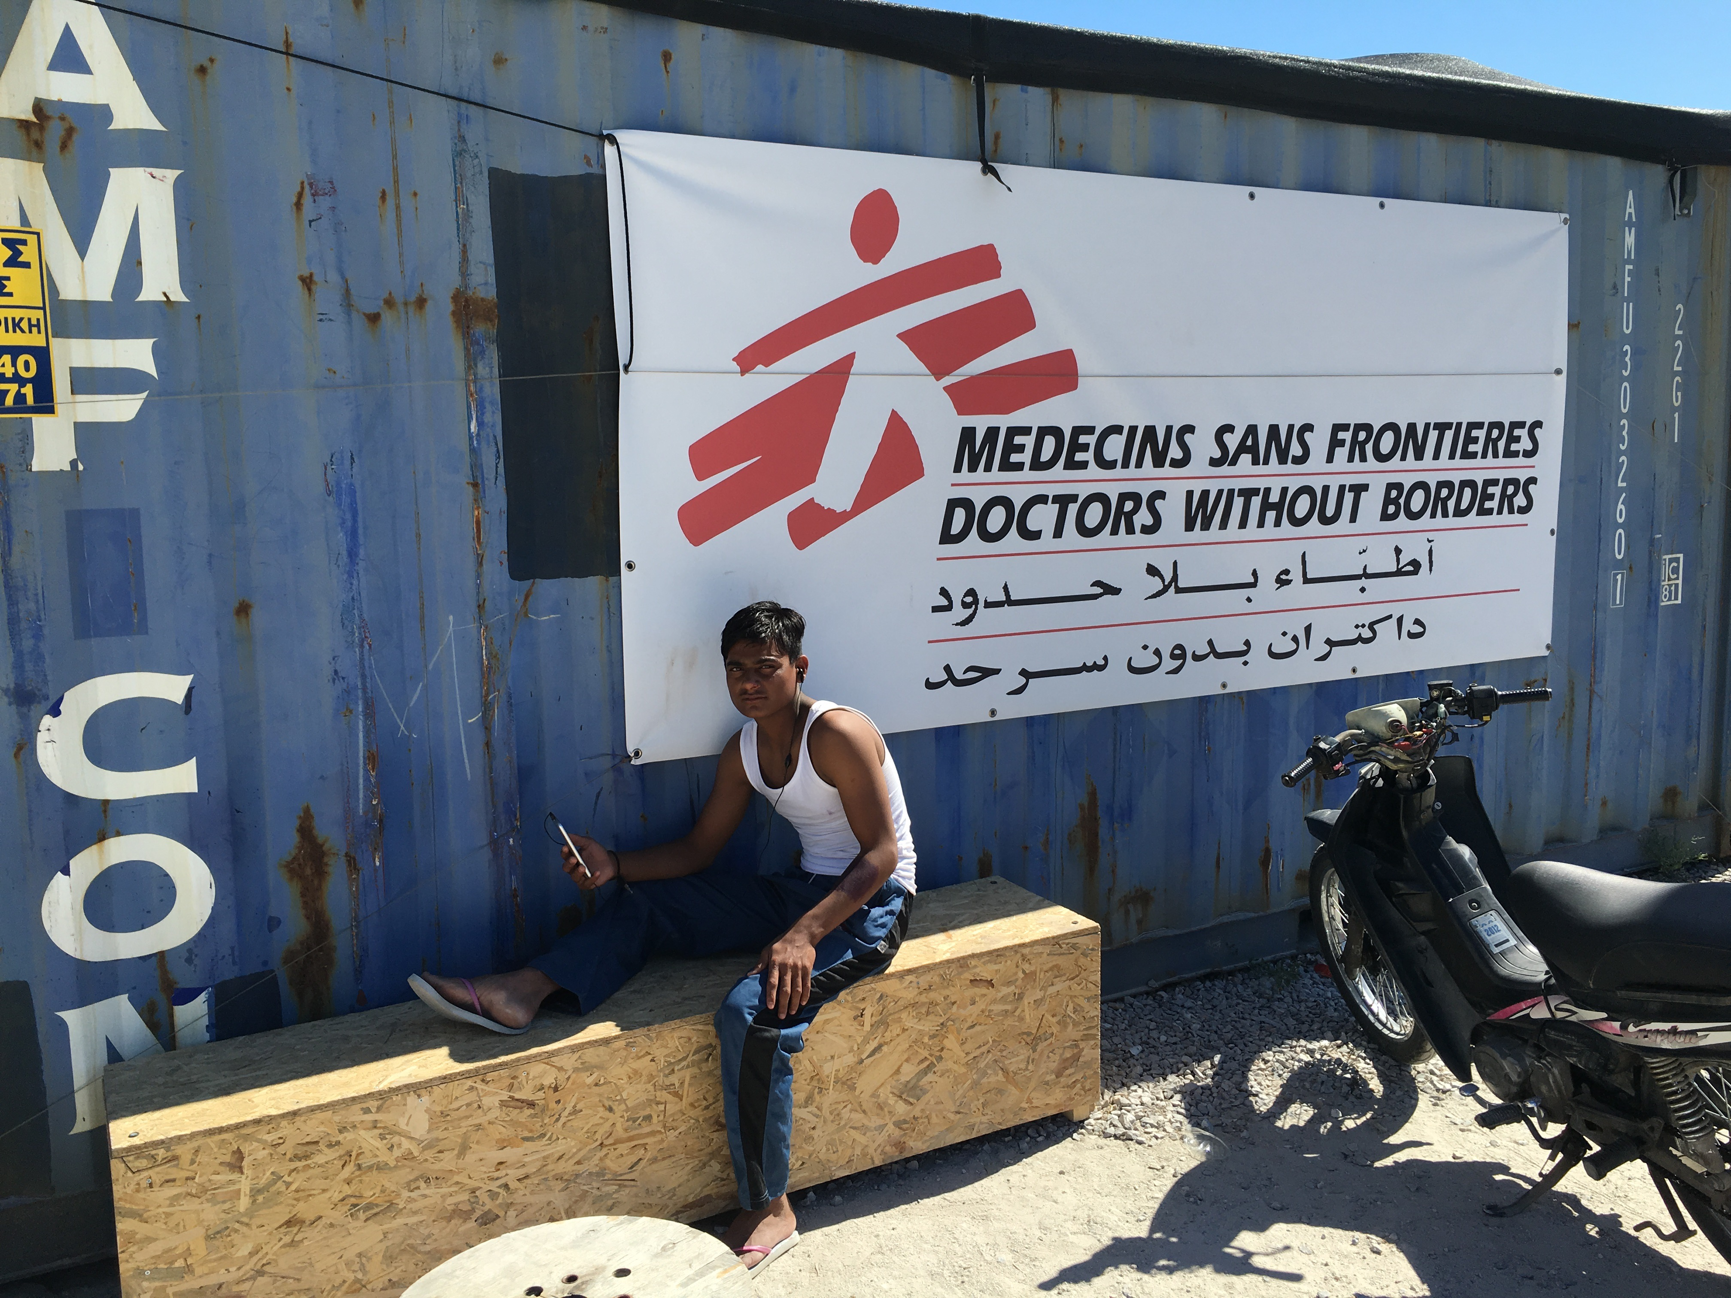

Slide 29
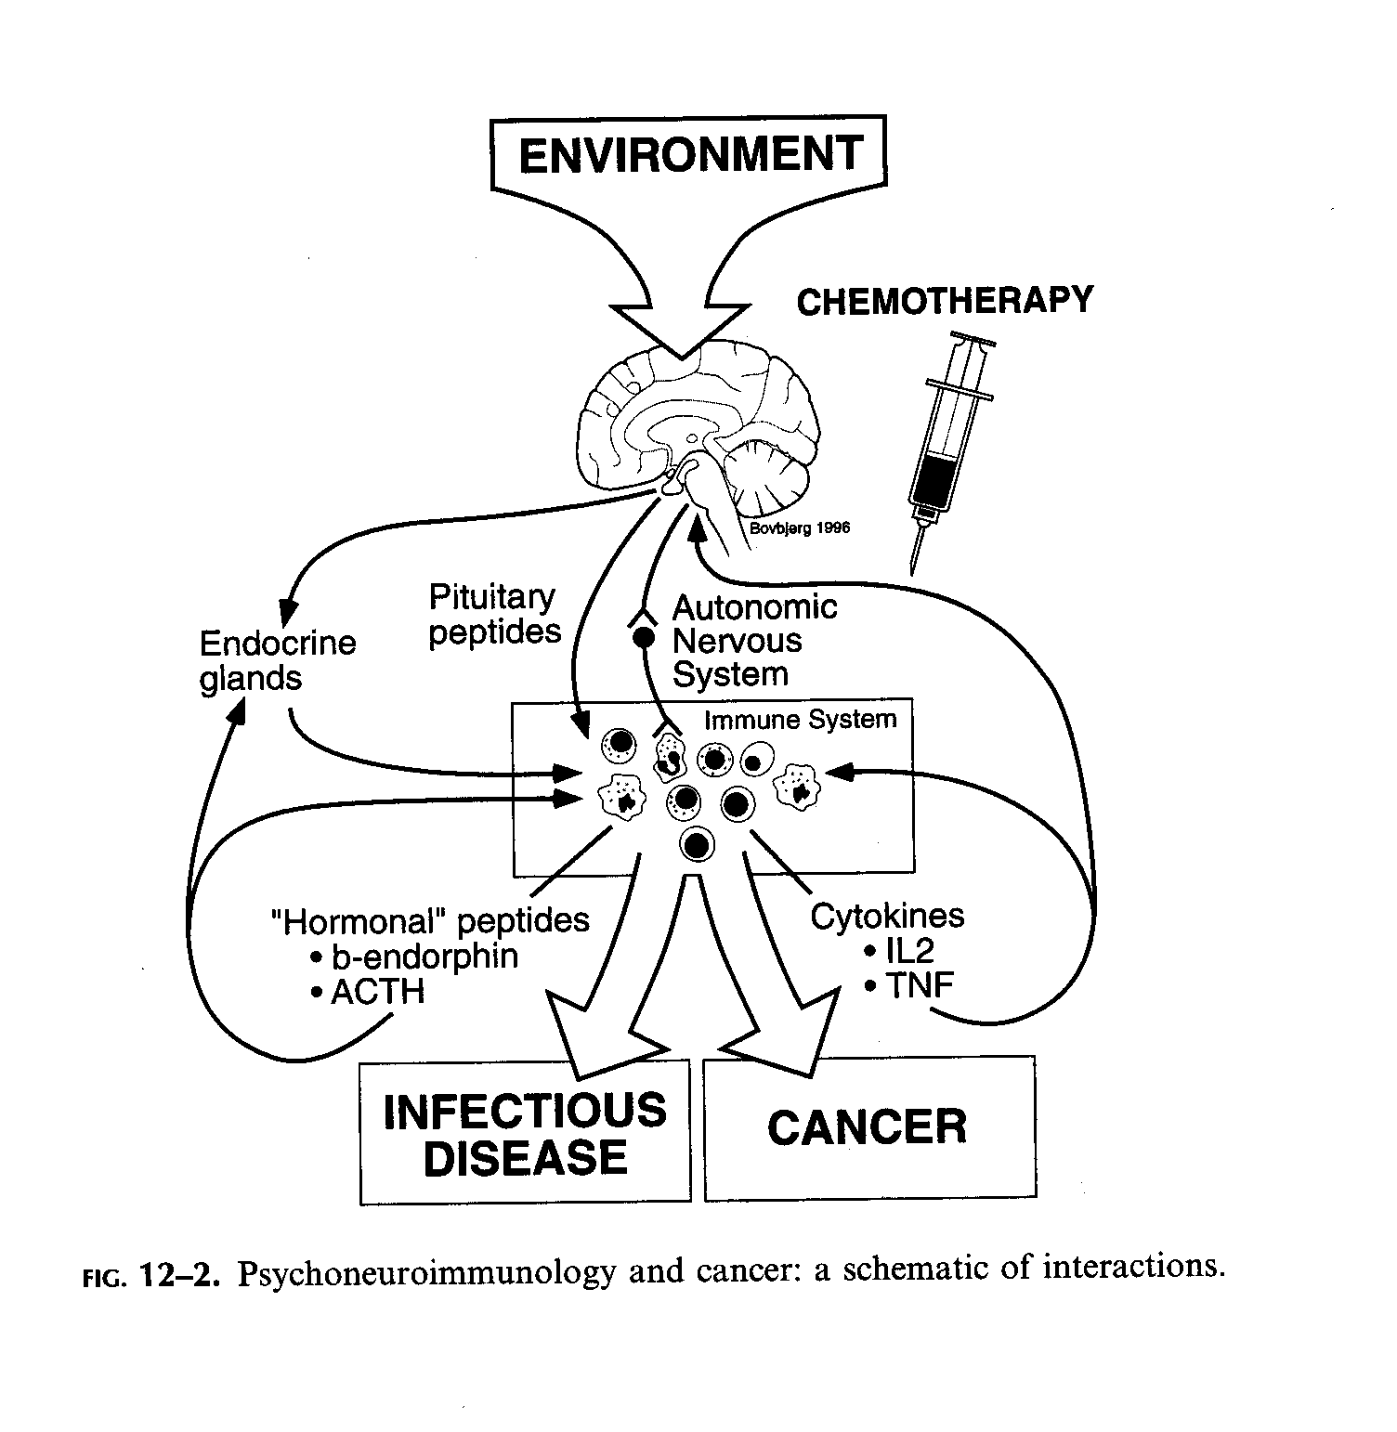


Stress causes illness
Illness causes stress
Notes:
Stress causes illness and Illness causes stress
The brain reacts to experiences – diagramed here as “ENVIRONMENT”
The body responds to signals from the brain through the nervous system, the endocrine system, and the immune system,
Through positive and negative feedback systems.
The mountains pictures here are the familiar mountains we look at every day. When I was diagnosed with cancer (multiple myeloma) in 1998, I tried to use them to remind me to relax. But the branches of the tree outside my window reminded me of the grin of the Cheshire Cat: You can’t relax, you have cancer. This was the hypervigalence of on-going traumatic stress.

Slide 30


Slide 31
Stress causes illness
Illness causes stress

Slide 32
Stress causes illness
Illness causes stress

Slide 33
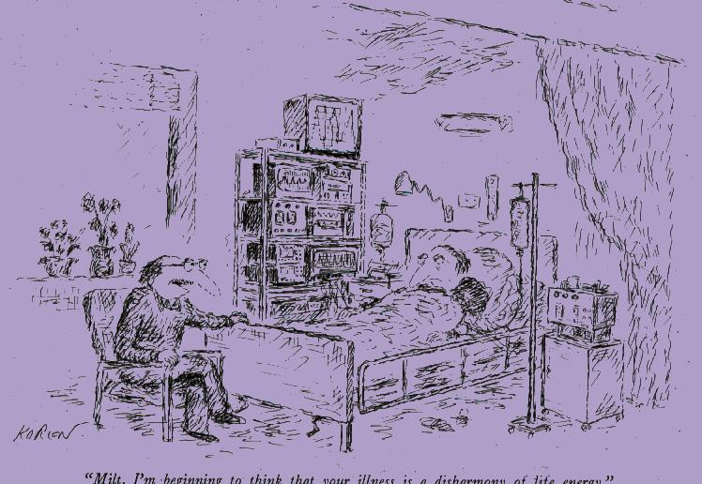
“Milt, I’m beginning to think that your
illness is a disharmony of life energy”

Slide 34

Sometimes things get so bad. . .
. . . It takes a psychiatrist to sort them out
Ibrahim al Jaffrey, Prime Minister of Iraq 2005-06
Notes:
This is Ibrahim al Jaffrey, the Prime Minister of Iraq from 2005-2006,
one of the most difficult periods of the war.
As the first prime minister after the dictator, he faced enormous challenges, politically and militarily.
A very learned man, particularly interested in Thomas Jefferson and American constitutional democracy,
his cabinet forged the constitution, which was the basis of the elections to follow.
I was privileged to have dinner with him once evening and photographed him in his library.

Slide 35
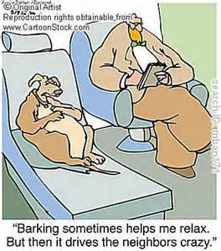
Factors affecting coping

Slide 36
What Can Physicians Do?
War has risk factors,
factors that can be: prevented from developing (primordial prevention)
and modified (primary prevention);
Once war has broken out, its course can be modified (secondary prevention)
and its damage can be addressed through healing and rehabilitation (tertiary prevention).
Health is a bridge to peace

Slide 37
Track Two Diplomacy
Montville maintains that there are two basic processes in track two diplomacy.
The first consists of facilitated workshops that bring members of conflicting groups together to develop personal relationships, understand the conflict from the perspective of others, and develop joint strategies for solving the conflict.
The second process involves working to shift public opinion: "Here the task is a psychological one which consists of reducing the sense of victimhood of the parties and re-humanizing the image of the adversary". (Davidson & Montville, 1981)
Notes:
Basically the approach to conflict resolution is a People to People approach.
While there is a tendency to think of nations as people – Iran wants such and such – when the people of Iran may hold views very different from its leaders.

Slide 38
Track Two Diplomacy
"non-governmental, informal and unofficial contacts and activities between private citizens or groups of individuals, sometimes called 'non-state actors’
Track Two has as its object the reduction or resolution of conflict, within a country or between countries, by lowering the anger or tension or fear that exist, through improved communication and a better understanding of each other's point of view”.
"Foreign Policy According to Freud",
in Foreign Policy (Davidson & Montville, 1981).

Slide 39
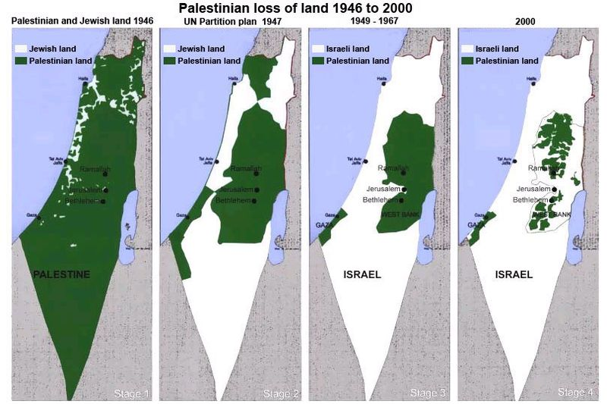
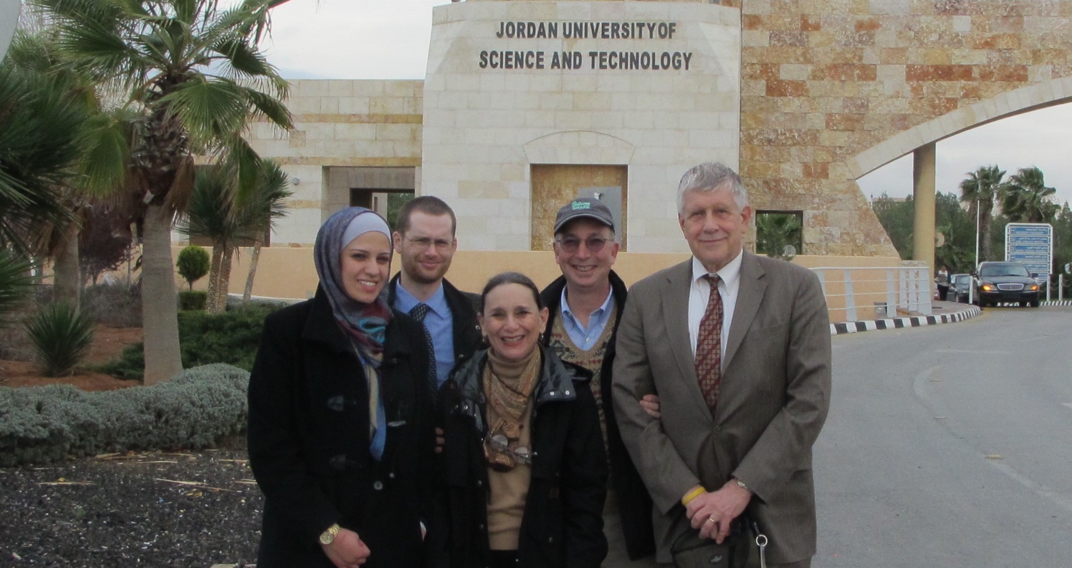
Palestine Medical Education Initiative pmedonline.org
The partnerships that are formed in this work—
across ethnic, religious, and national divides—
not only enable the implementation of programs that improve health;
these collegial relationships also are a microcosm of the world that we hope to see.

Slide 40
Palestine Medical Education Initiative
(pmedonline.org)

Slide 41
U.S. foreign policy:
Smart Power
Defense
Diplomacy
Development

Slide 42
How much do you think the US spends on foreign aid?
1%
5%
10%
20%

Slide 43
How much do you think the US should spend on foreign aid?
1%
5%
10%
20%

Slide 44
Smart Power
Defense
Diplomacy
Development
The US will spend $38 billion on foreign aid in 2016.
This = less than 1% of the US $4 trillion budget
DOD $524 billion
DOS $50 billion

Slide 45
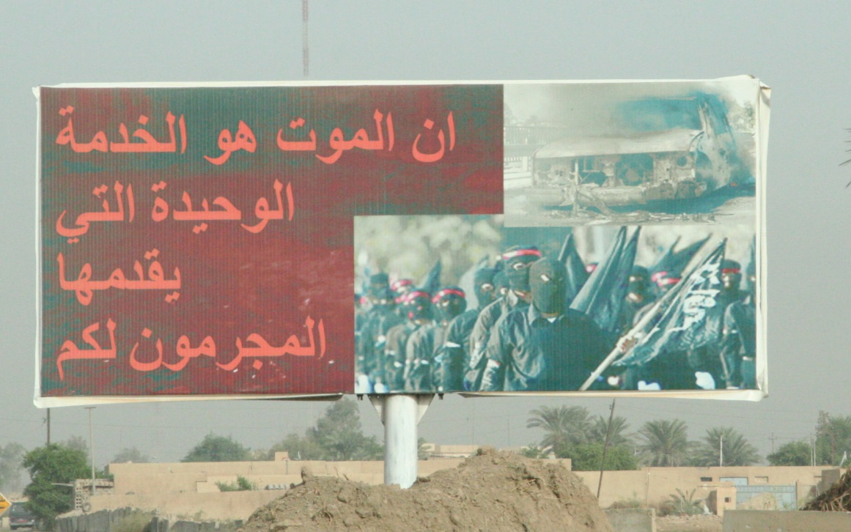
Some Distinctions:
War as Metaphor
Criminal act v. Act of War
Police action v. Nationalistic War
Nationalistic War v. Metaphorical War
  War on poverty
  War on drugs
  War on terror
U.S. War on Terror v. Global War on Terror
War v. Game
The criminal offer nothing to society, but death
Baghdad, 2008
Notes:
Death is the only service a criminal provides.

Slide 46

Vicarious Trauma: Helping Hurts
http://www.youtube.com/watch?v=K-aAOLM5oSY&feature=relmfu

Slide 47
Summary
Disaster situations, like tsunamis, earthquakes, and especially wars, remind us that physical health cannot really be separated from mental well-being.
Trauma has health consequences, physical and mental, and coping with trauma requires an integrated understanding.
In Iraq, people have shown extraordinary resilience; yet they suffer increased susceptibility to cancer, heart disease, and a host of physical manifestations of stress-related conditions.
Notes:
In consideration of the relationships between stress, trauma, and resilience, both psychologically and physiologically,
I would like to suggest that health is an integrative concept involving biological, psychological, and social factors, which are all interrelated.

Slide 48
Conclusion
The World Health Organization long ago recognized the importance of not only biological but also psychosocial factors in illness, when it offered its significant definition of health as “bio-psycho-social well-being, not just the absence of disease.” (WHO,1946).
Because of the dynamic interactions between biological and psychosocial factors we witness in global disasters and complex emergencies, I believe that there is a stronger statement that needs to be made. The artificial distinction between health and mental health obscures rather than clarifies the integral relationship of mind and body. There is no real difference between health and mental health. Health is health.
The bio-psycho-social approach is not just a good idea, it is a reality based on an increasing body of scientific evidence.
The challenge now is to apply that knowledge to practice in both resource rich and resource poor settings.
“Global” health is not just about health somewhere else.
“Global” in this sense means “comprehensive”.
Notes:
Note that the BPS definition is nothing new – It was part of the WHO charter in 1946.
At the end of WWII one of the greatest health crises,
the world faced was the post-war refugee crisis with 40 million displaced persons, forced from home.

Slide 49
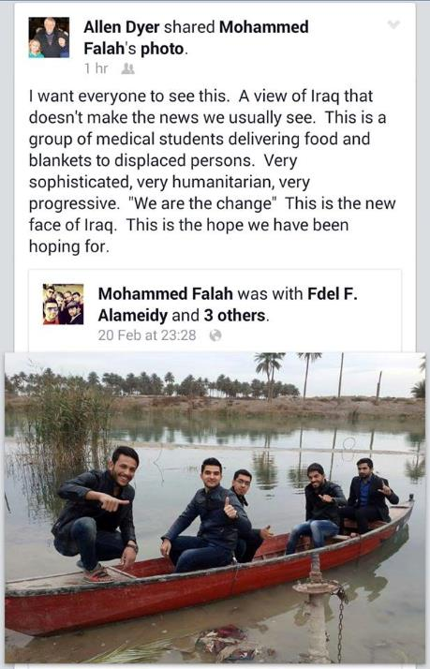

شيء يفرح القلب .. عندما تری شخصا قضيت معه فتره لا تزيد عن اليومين من خلال المؤتمر الطبي الذي اقامته كليه الطب في 15 / 2 / 2015 .. ومن خلال المحادثات التي جرت معه وكذلك من خلال الذي رءاه من تنظيم للمؤتمر والذي قدم له هنا من عنايه واهتمام من قبل السيد العميد الدكتور مشتاق وتوت وباقي اللجان .. تراه يقدر ويفهم الفكره التي نسعی لها وهي مجتمع عراقي جديد يسعی للتطور والنمو .. ويساعد بعضه بعضا .. ونراه يقدر دور الشباب في التغيير نحو الافضل .. وليس كل ما يقال عن العراق في الاخبار صحيح .. فشكرا جزيلا له ..
الصوره منقوله من صفحه د.الن داير
When we see person that we spent with him through medical conference held by the college of Medicine in Babylon at 15/02/2015 ..
Through the conversations with him, as well as through who gave him care and attention specially Dr.moshtak witwit .. we can see that he understood the idea .. that we have a new Iraqi society which seeks to develop and grow .. and help each other .. and we see the role of youth in the estimated change for the better .. Thank you very much for this Allen Dyer ..
Image from Allen Dyer profile
MD.PHD. professor
A physician and professor at George Washington University, US
Notes:
I end with an optimistic note on the resilience of the human spirit. I posted this picture on Facebook: A group of medical students at the University of Babylon have founded their own NGO, We are the Change, echoing Gandhi’s admonition to be the change you want to see in the world. They are pictured here delivering food and blankets to IDPs Internally Displaced Persons along the Euphrates River.
This is the new face of Iraq.
This is the hope we have been hoping for.
To which Mohammed Falah replied,
We can see that he understand the idea – that we have a new Iraqi society which seeks to develop and grow and help each other and we see the role of youth
in the estimated change for the better
Thank you very much for this.

